Slide 1
Network Effects
Ken Church
Sept 17, 2024

Slide 2
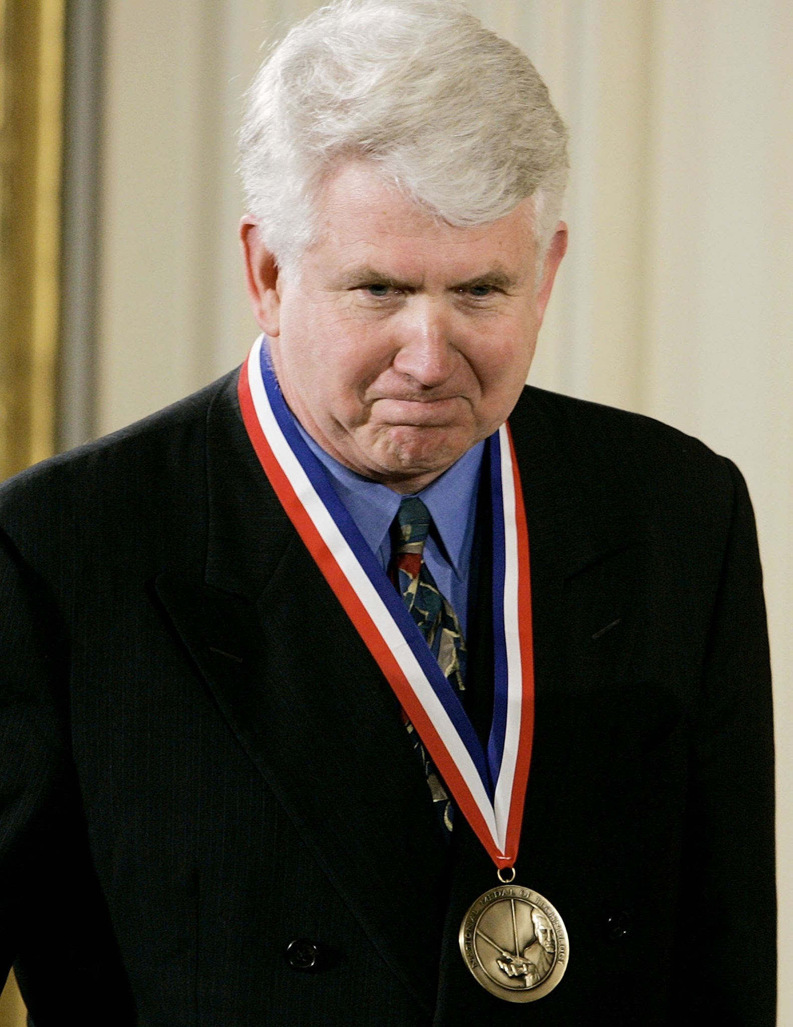
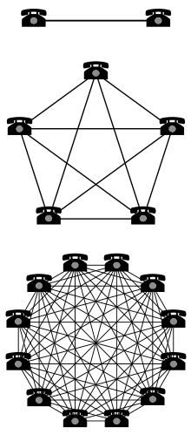
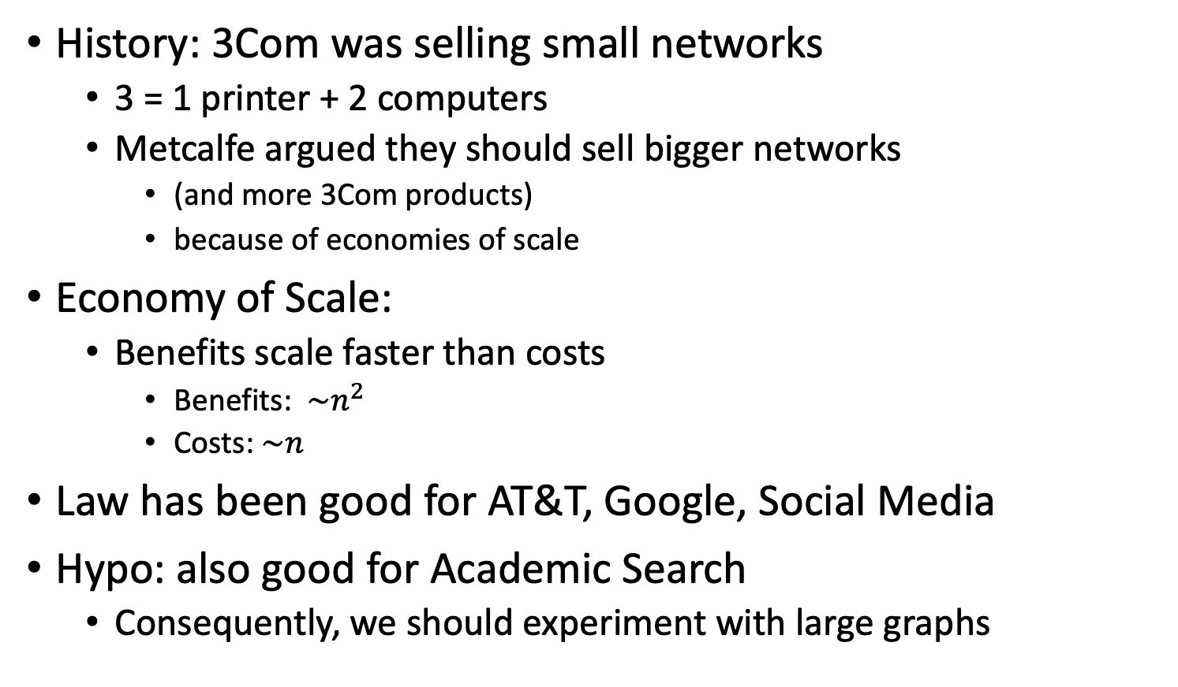
Metcalfe’s Law (Network Effects)
History: 3Com was selling small networks
3 = 1 printer + 2 computers
Metcalfe argued they should sell bigger networks
(and more 3Com products)
because of economies of scale
Economy of Scale:
Benefits scale faster than costs
Benefits: $\sim n^{2}$
Costs:$\sim n$
Law has been good for AT&T, Google, Social Media
Hypo: also good for Academic Search
Consequently, we should experiment with large graphs

Slide 3
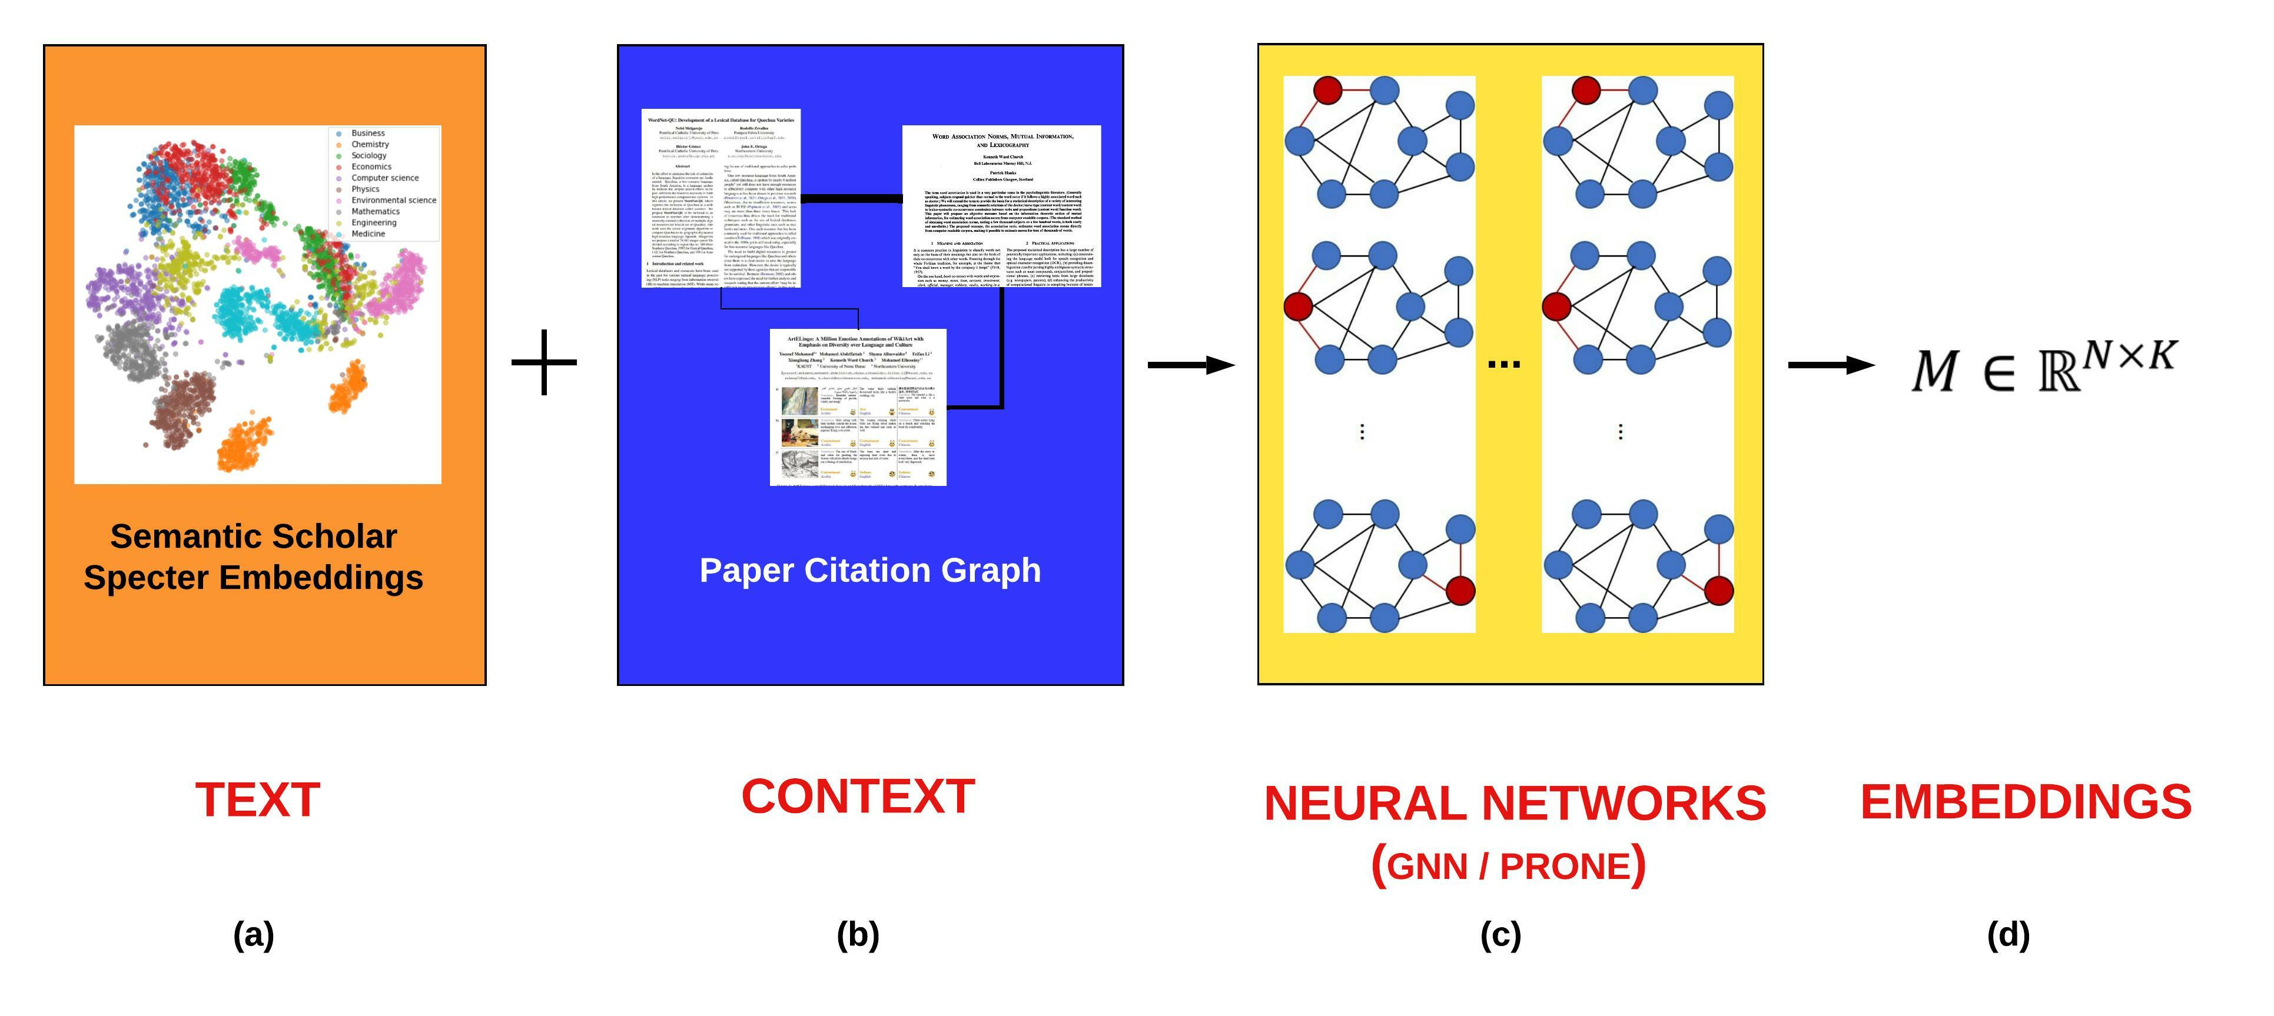
Better Together: Text (Titles, Abstracts, Body); Context (Citations)
Specter, SciNCL
ProNE

Slide 4
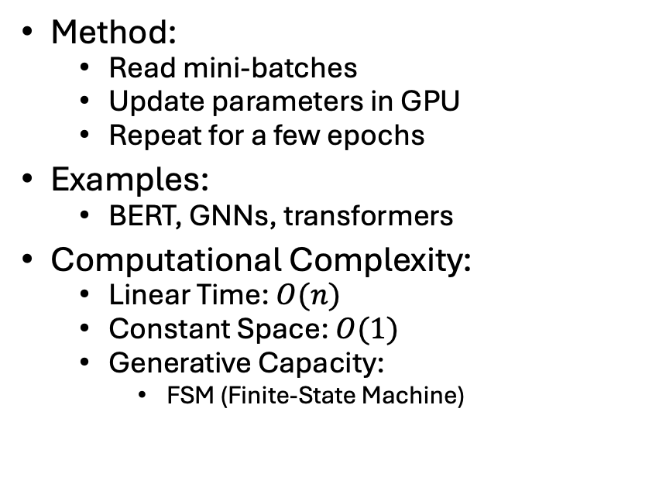
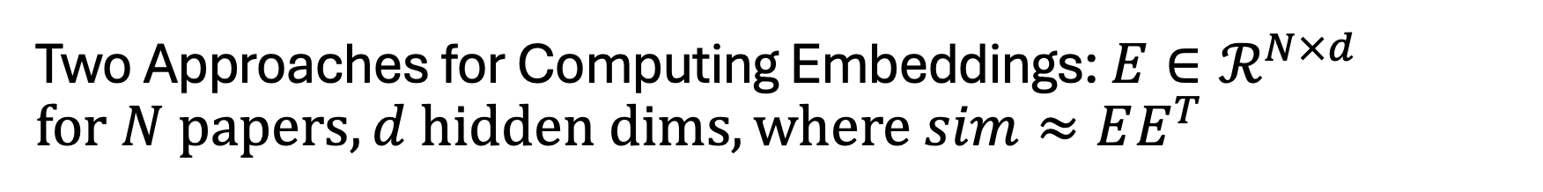
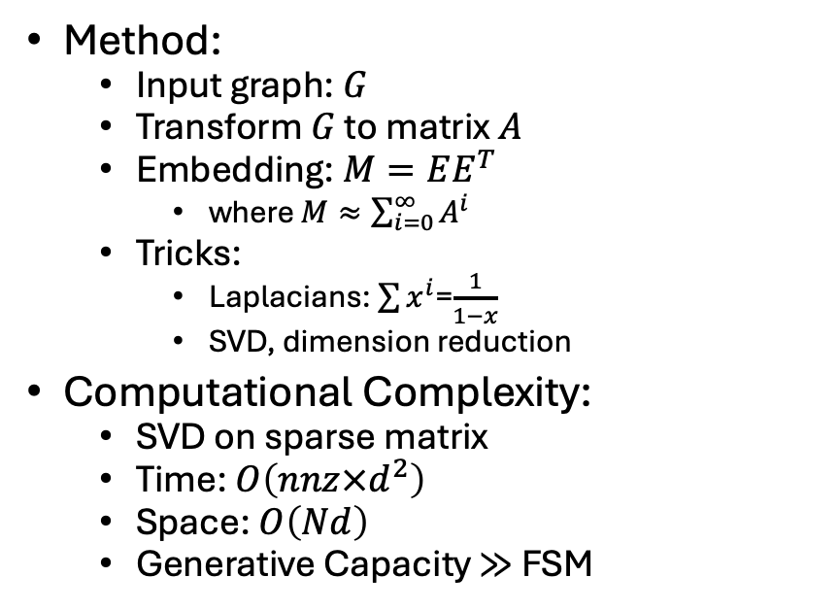
Two Approaches for Computing Embeddings: $E∈ℛ^{N×d}$ $$for N papers, d hidden dims, where sim≈EE^{T}$$
Standard Mini-Batch Recipe
Spectral Clustering
Method:
Read mini-batches
Update parameters in GPU
Repeat for a few epochs
Examples:
BERT, GNNs, transformers
Computational Complexity:
Linear Time: $O(n)$
Constant Space: $O(1)$
Generative Capacity:
FSM (Finite-State Machine)
Method:
Input graph: $G$
Transform $G$ to matrix $A$
Embedding: $M=EE^{T}$
where $M≈\sum_{i=0}^{∞}{A^{i}}$
Tricks:
Laplacians: $\sum{x^{i}}$=$\frac{1}{1−x}$
SVD, dimension reduction
Computational Complexity:
SVD on sparse matrix
Time: $O\left(nnz×d^{2}\right)$
Space: $O\left(Nd\right)$
Generative Capacity $≫$ FSM

Slide 5
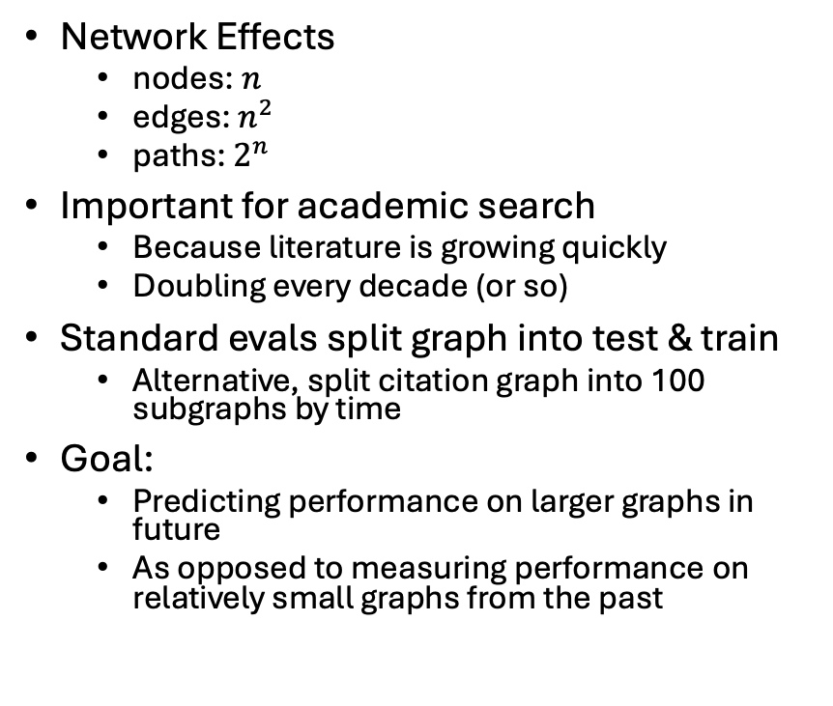
Network Effects
nodes: $n$
edges: $n^{2}$
paths: $2^{n}$
Important for academic search
Because literature is growing quickly
Doubling every decade (or so)
Standard evals split graph into test & train
Alternative, split citation graph into 100 subgraphs by time
Goal:
Predicting performance on larger graphs in future
As opposed to measuring performance on relatively small graphs from the past

Slide 6
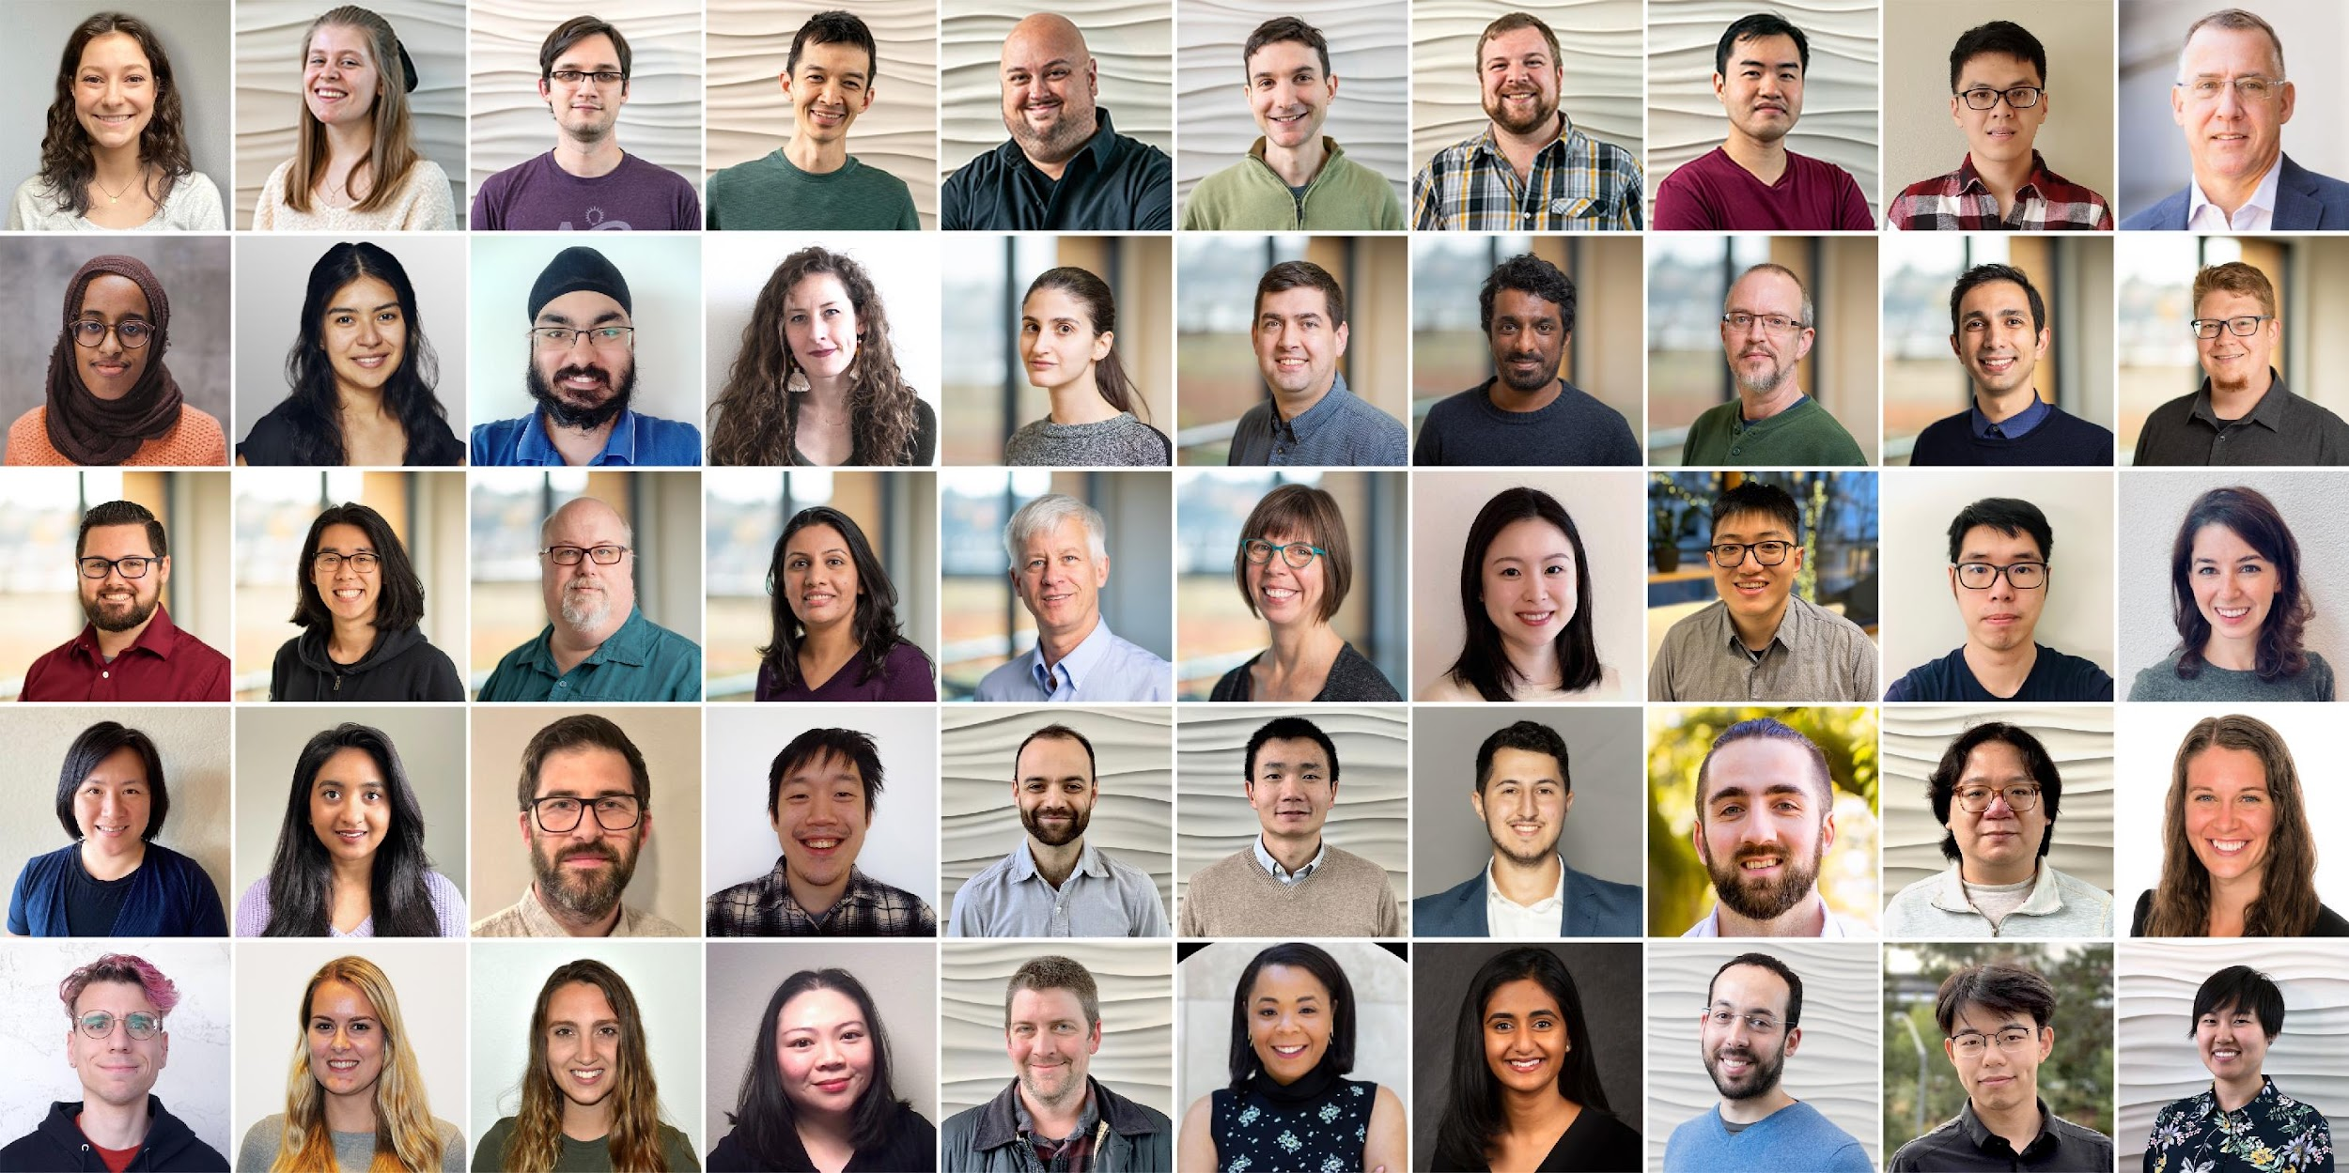
Semantic Scholar (S2): Significant Effort (slide from Dan Weld)
50 person team
7 year project
207M+ scientific paper index
8M+ monthly active users

Slide 7
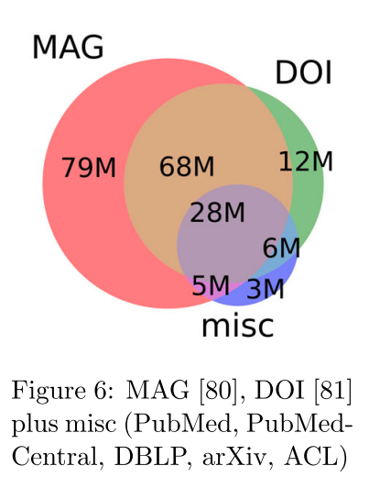
Semantic Scholar (S2)
Seven Sources
Fields of Study
Medicine (45M) | Engineering (8M) | Business (4M) | Geology (3M)
Chemistry (13M) | Physics (7M) | Sociology (3M) | History (2M)
Computer Science (13M) | Psychology (7M) | Geography (3M) | Art (2M)
Biology (13M) | Mathematics (5M) | Economics (3M) | Philosophy (1M)
Materials Science (10M) | Political Science (4M) | Environmental Science (3M)

Slide 8
Federated API
Query
(paper id)
Recommendation APIs
Embeddings
Semantic Scholar
Specter
Federated Recommendation API
PubMed (Medicine)
ProNE
ADS (Astronomy)
Recommendations
(paper ids)

Slide 9
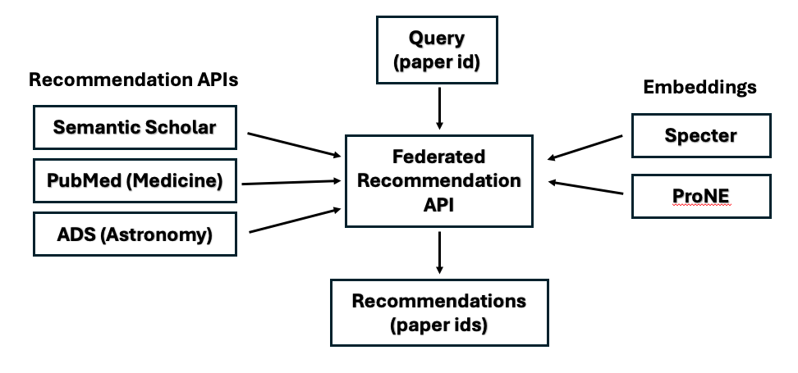
Motivation for a Federated API
Easy to create web sites
https://recommendpapers.xyz
To compare and contrast
Different APIs/Embeddings
Different recommendations are different
Almost no overlap

Slide 10
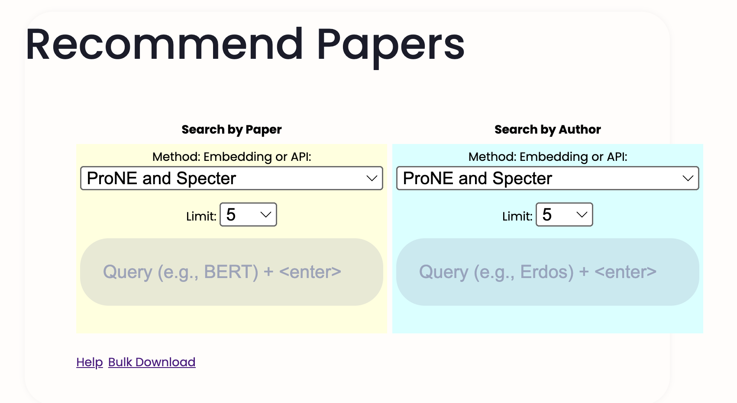
https://recommendpapers.xyz

Slide 11
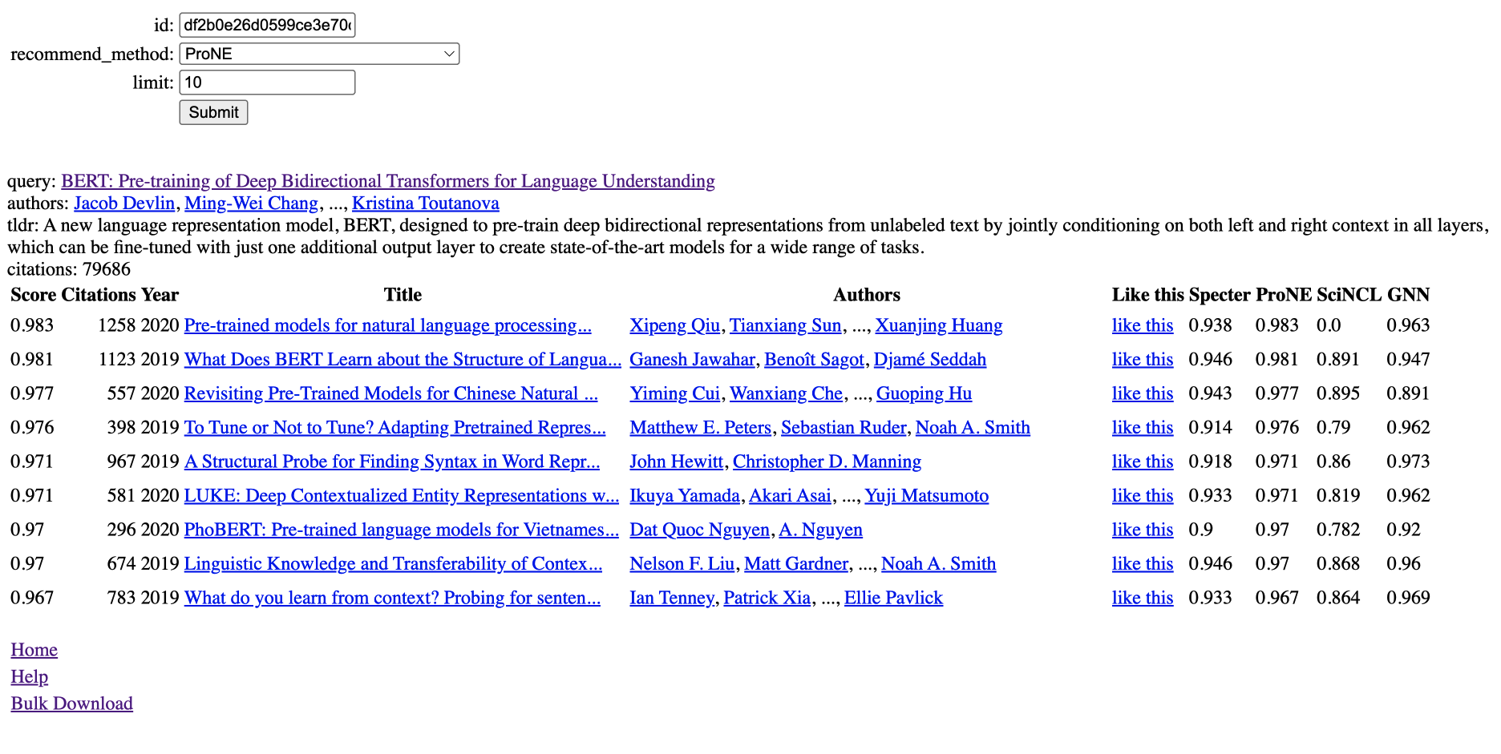

Slide 12
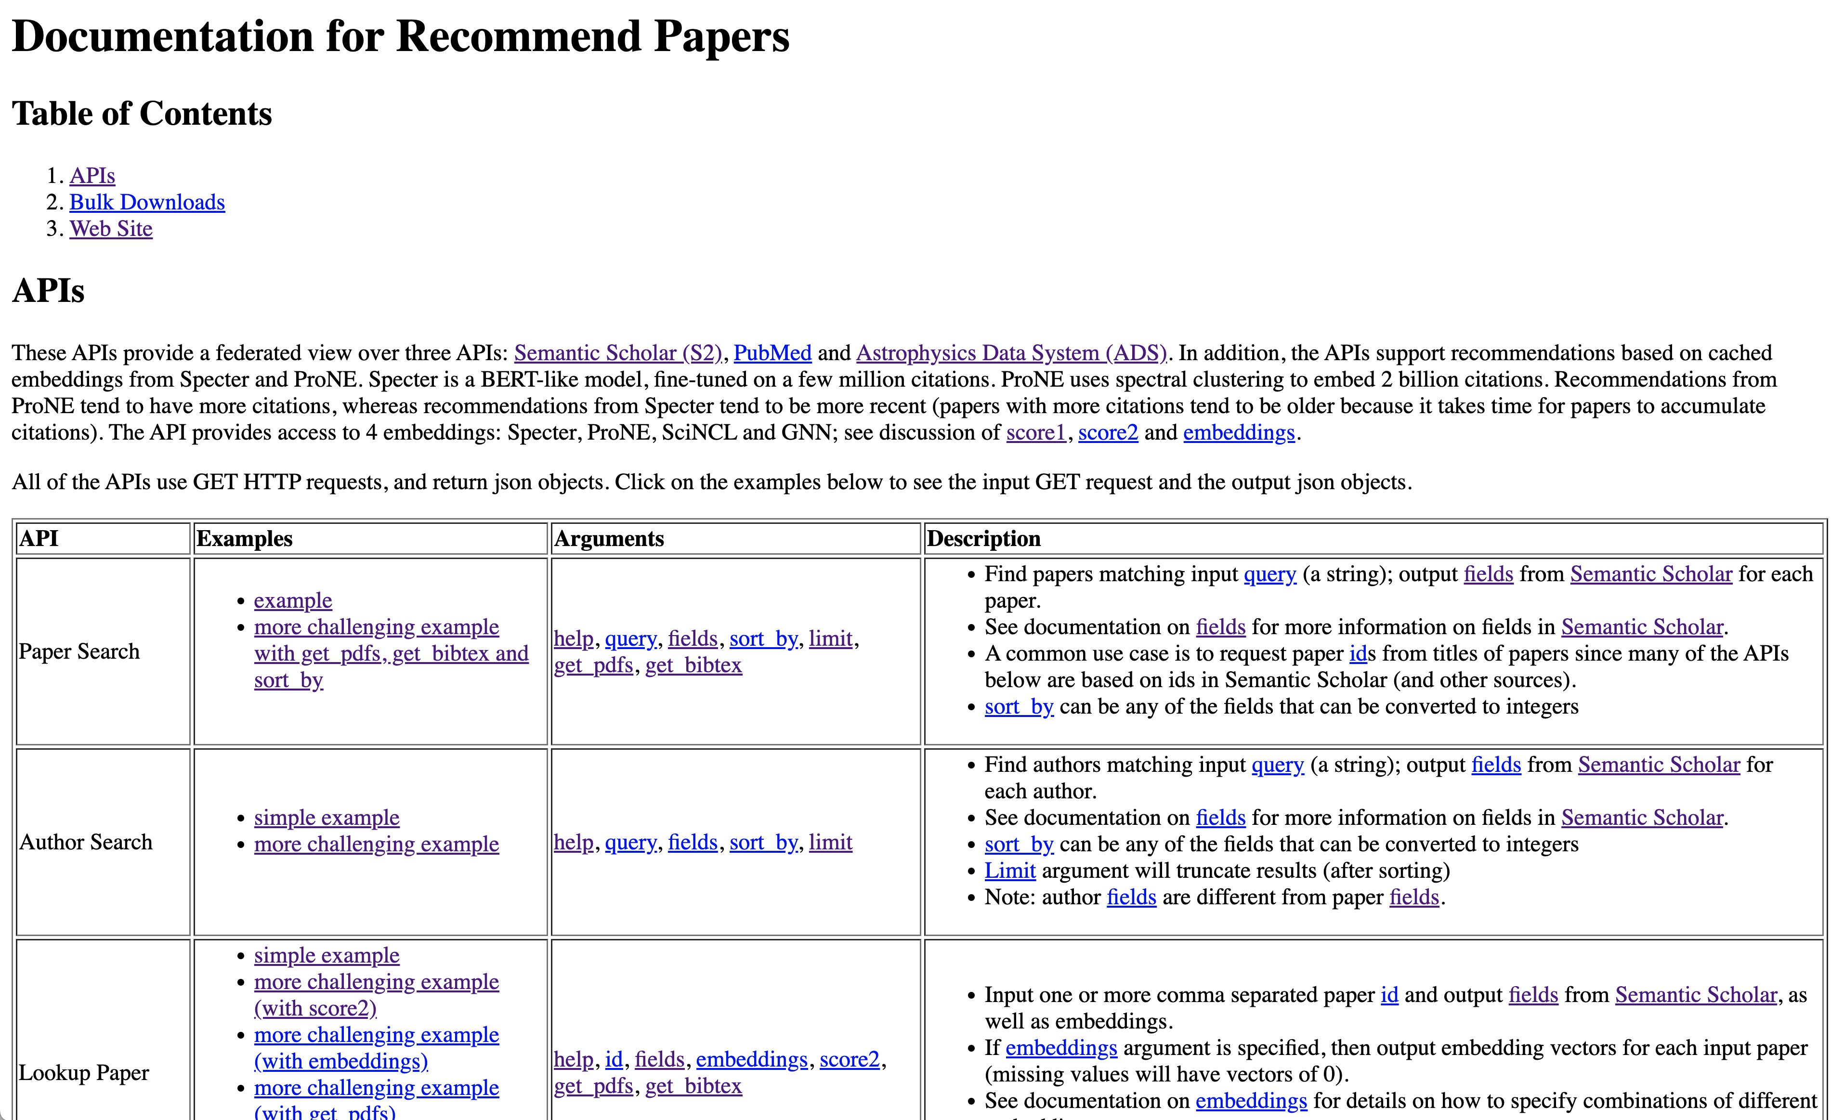
API Documentation

Slide 13
10 Entry Points
Paper Search:
Input query (strings); output papers ids
Author Search:
Input query (strings); output author ids
Lookup Paper:
Input paper ids; output fields (titles, abstracts, embeddings, etc.)
Lookup Author:
Input author ids; output fields (titles, abstracts, embeddings, etc.)
Lookup Citations:
Lookup Citations for paper id and output fields from Semantic Scholar for each citation
Coauthors:
Input a query (a string); output a list of coauthors (filtered by after_year) for each matching author id.
Recommend Papers:
Input a paper id and a recommendation method;
output paper ids (with fields, scores, etc.)
Recommend Authors:
Input an author id and a recommendation method;
output paper ids (with fields, scores, etc.)
Compare and contrast papers with chatbot/RAG
Compare and Contrast texts with chatbot/RAG

Slide 14
Use Case: Assign Papers to Reviewers
Had a very promising call with a NASA PM Megan Ansdell
It takes her about a week to put together a panel
She needs to find reviewers that
are qualified
diverse over experience, etc.
avoid conflicts of interest
She can program in Python (and use these APIs)
She wrote a tool to check proposals for anonymity (pronouns)
Many of her peers are more senior than she is
So she runs her tool on their proposals
We talked about a sole source grant, so we could work together on this use case
More generally, I would like to scale this up to large conferences

Slide 15
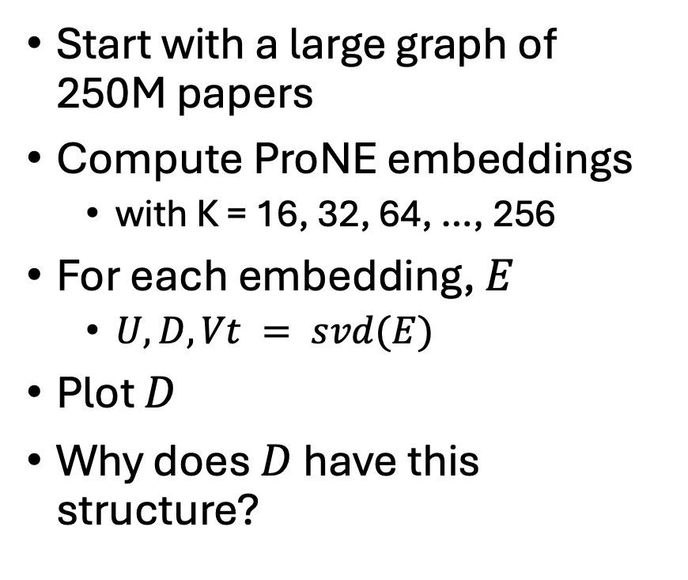
Eigenvalues by K (# Hidden Dimensions)
Start with a large graph of 250M papers
Compute ProNE embeddings
with K = 16, 32, 64, …, 256
For each embedding, $E$
$U, D, Vt = svd(E)$
Plot $D$
Why does $D$ have this structure?

Slide 16
Eigenvalues by Bin

Slide 17
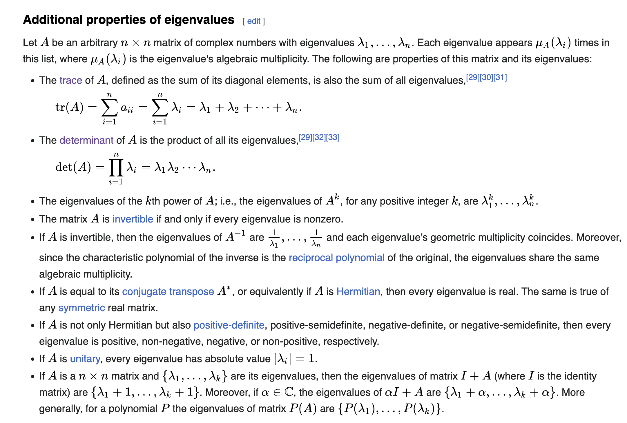
https://en.wikipedia.org/wiki/Eigenvalues_and_eigenvectors

Slide 18
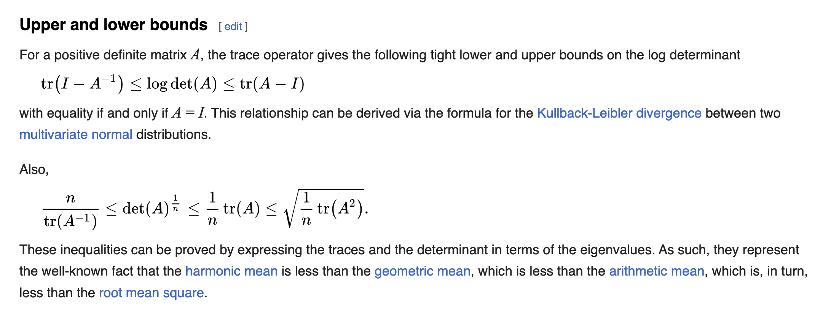
https://en.wikipedia.org/wiki/Determinant

